Slide 1
Networking Review
LAW 379
Spring 2020
Dr. Seth James Nielson

Slide 2
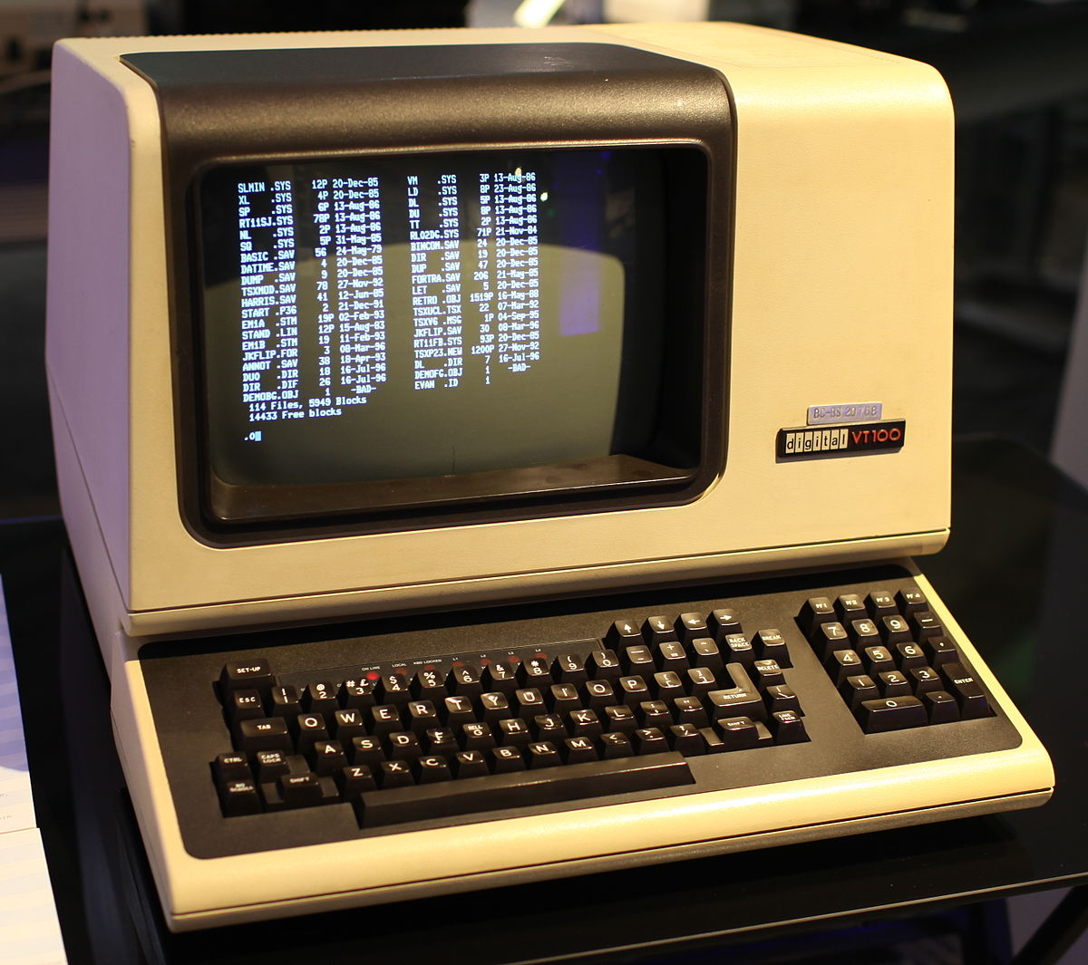

Computing 1960-1980 (ish)
NETWORK
This Photo by Unknown Author is licensed under CC BY-SA-NC
“DUMB” TERMINAL
MAINFRAME
Basically, just a keyboard and monitor
All the processing (computer brains) happens here
This Photo by Unknown Author is licensed under CC BY-SA

Slide 3
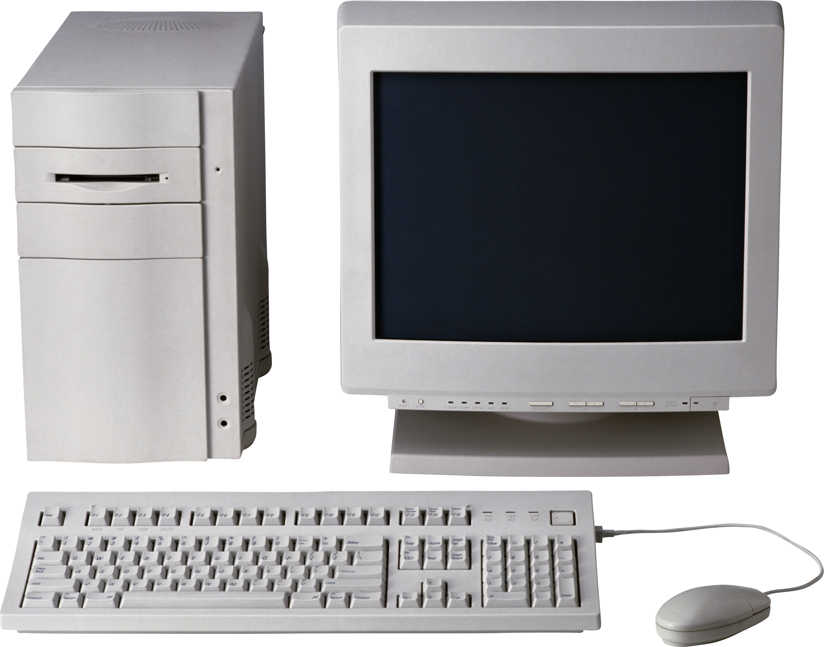
Computing 1980-2000 (ish)
For the most part, NO NETWORKING
This Photo by Unknown Author is licensed under CC BY-NC

Slide 4
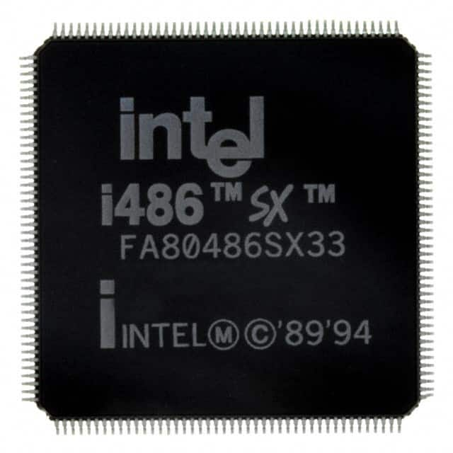
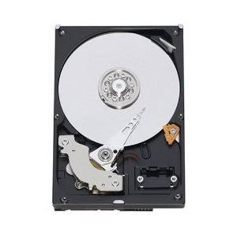
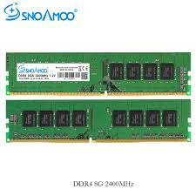
Three Major Computer Parts
Central Processing Unit (CPU)
Hard Drive
Random Access Memory
(RAM)
This Photo by Unknown Author is licensed under CC BY-NC

Slide 5
First, a Word About Data
Computers store, process, and manipulate all data as BINARY NUMBERS
Everything is a binary number. Games, programs, music, word documents
The binary numbers are *interpreted* as letters, music, etc

Slide 6
Quick Binary Lesson
Base 10 Numbers
Base 2 Numbers
10³ = 1000 | 10² = 100 | 10¹ = 10 | 10⁰ = 1
3 | 0 | 9 | 5
(3X1000) + | (0X100) + | (9X10) + | (5X1)
3000 + | 0 + | 90 + | 5
3095
2³ = 8 | 2² = 4 | 2¹ = 2 | 2⁰ = 1
1 | 0 | 1 | 0
(1X8) + | (0X4) + | (1X2) + | (0X1)
8 + | 0 + | 2 + | 0
10

Slide 7
What are These Binary Numbers?
Remember 8, 4, 2,1 columns.
If there’s a one, add the column:
0110 = 4+2 = 6
1001 = 8+1 = 9
Binary 1000?
Binary 0100?
Binary 0010?
Binary 0001?
Binary 0101?
Binary 1010?
Binary 1111?

Slide 8

Decode This Shirt

Slide 9
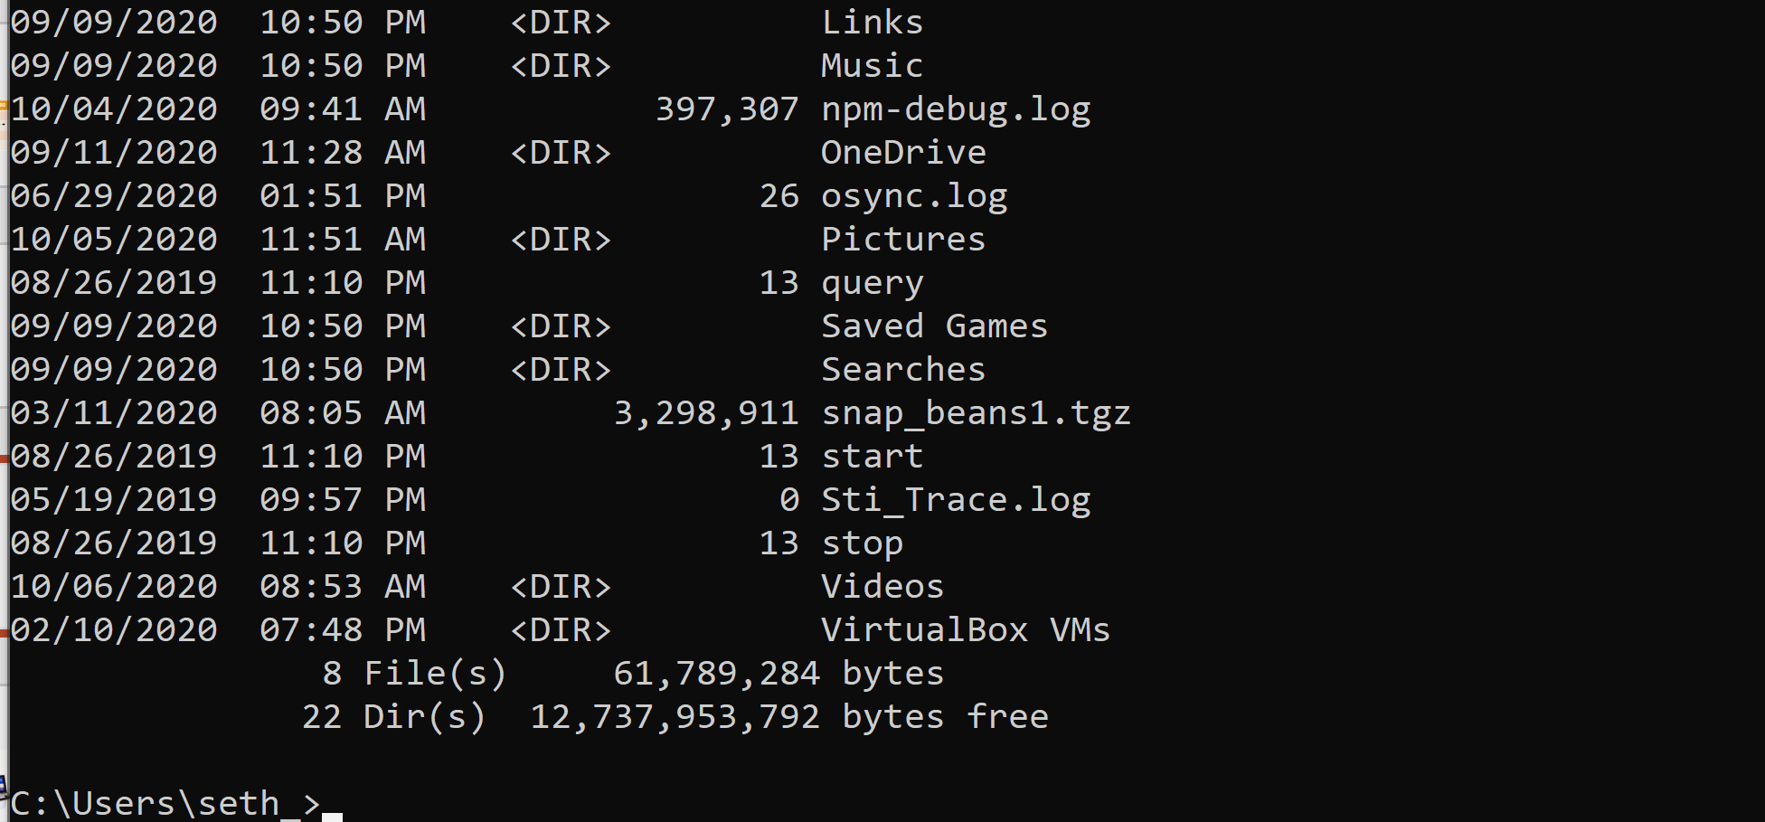
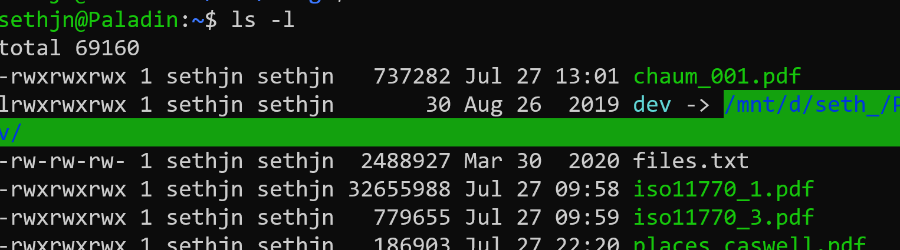
Binary Sizes
A one or a zero is a “bit”
8 bits is a byte
Let’s use our command line to see how big files are:
Open a terminal on Mac or the cmd shell on Windows
Type “ls –l” on Mac or “dir” on Windows

Slide 10
Processors and Binary
Computer “Instruction” is just a binary number. In older computers, like the 486 shown here, it was 32-bit. In more modern processors it is 64-bit.
1 | 0 | 0 | 1 | 1 | 0 | 0 | 0 | 0 | 1 | 1 | 0 | 0 | 1 | 0 | 0 | 0 | 0 | 1 | 1 | 1 | 1 | 1 | 0 | 1 | 0 | 1 | 0 | 0 | 1 | 1 | 0

Slide 11
CPU Instructions
The instruction is broken down into pieces. One part is called the “op code” or operation code, it tells the computer what to do. The other parts are parameters. Each instruction “add”, “subtract,” etc. has its own op code.
1 | 0 | 0 | 1 | 1 | 0 | 0 | 0 | 0 | 1 | 1 | 0 | 0 | 1 | 0 | 0 | 0 | 0 | 1 | 1 | 1 | 1 | 1 | 0 | 1 | 0 | 1 | 0 | 0 | 1 | 1 | 0
OP CODE
PARAMETER 1
PARAMETER 2

Slide 12
Program Stored On Disk
32-bit instruction
32-bit instruction
Program is a list of instructions
Processor executes one at a time.
Some instructions are “branches”
A branch jumps ahead or behind in the list
Often “conditional” (e.g., if x > 0 then jump)
32-bit instruction
32-bit instruction

Slide 13
Running a Program
HARD DRIVE
Program
(List of Instructions)
RAM
Program
(List of Instructions)
Single Instruction
Program is
copied to RAM
(RAM is faster)
1 Instruction at a time
loaded by the processor

Slide 14
Data Too
HARD DRIVE
Program
(List of Instructions)
RAM
Program
(List of Instructions)
Data
Single Instruction
Data File
Instruction can manipulate instructions (branching), read or write from
data in RAM or load or save data from files on disk.
(All are just binary numbers)

Slide 15
Why This is Useful
Everything in a computer is a number. Programs, Data, etc
This is great because programs and data can be stored the same way
Everything can be copied over a network the same way

Slide 16
Binary is Often Represented as Hex
Our normal numbers are written in Base 10
Binary is Base 2
For “short hand”, computer numbers are often written in Base 16
This is because there is a 1:1 mapping between 4 bits and 1 Hex number:
0000 – 0 | 0100 – 4 | 1000 – 8 | 1100 – C (hex 12)
0001 – 1 | 0101 – 5 | 1001 – 9 | 1101 – D (hex 13)
0010 – 2 | 0110 – 6 | 1010 – A (hex 10) | 1110 – E (hex 14)
0011 – 3 | 0111 - 7 | 1011 – B (hex 11) | 1111 – F (hex 15)

Slide 17
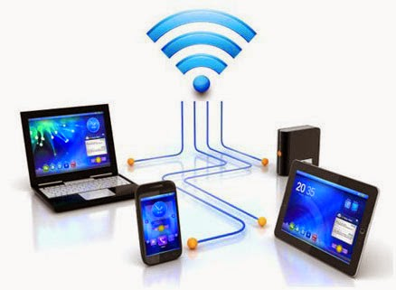

Computing 2000 – Present
NETWORK
This Photo by Unknown Author is licensed under CC BY
This Photo by Unknown Author is licensed under CC BY-NC-ND

Slide 18
General Ideas Behind Client-server
Put a bunch of resources in a high-performance, centralized machine (SERVER)
Clients can be much “dumber” by comparison
Much more efficient
Sharing data between devices, applications, and people (and marketing)
Access from multiple locations (including hackers!)
Time-sharing a central machine is more scalable and cost-effective

Slide 19
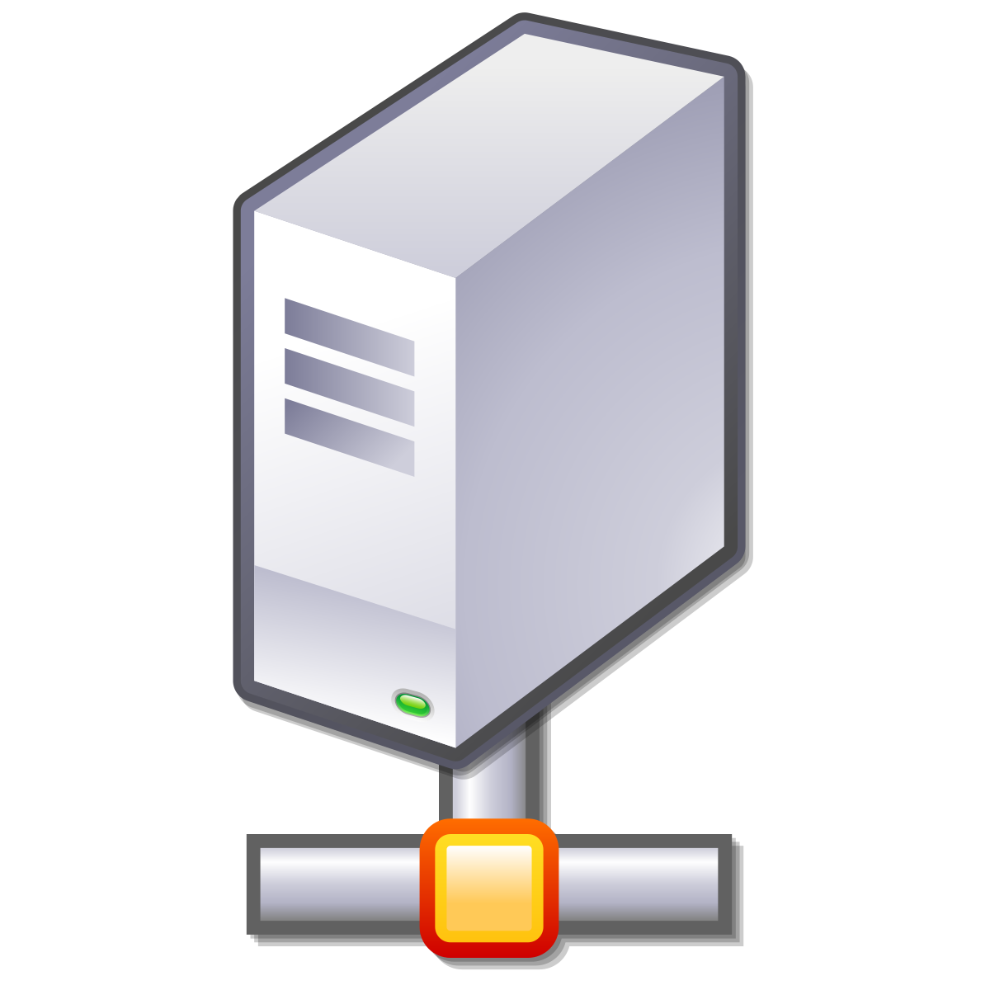
Confusing Meaning of “Server”
Server sometimes refers to the actual physical machine
Server sometimes refers to the computer program that provides service
Really, a machine is a “server” (machine) if it has one or more server programs running
Web Server
Program
Game Server
Program
This Photo by Unknown Author is licensed under CC BY-SA

Slide 20
Server Abstraction
I’m Lonely. I wish someone would talk to me!
This Photo by Unknown Author is licensed under CC BY-SA
SERVER (Program) LISTENS FOR INCOMING REQUESTS

Slide 21
Addresses Needed
The server can’t receive a request without an “address”
Typically identify machines with an Internet Protocol (IP) address
Typically identify programs on the machine with a “port”
TCP ports are for guaranteed delivery, like for file transfer (most common)
UDP ports are for best-effort delivery, like streaming music or games

Slide 22

Assigning an Address and Port
Now I have an Address/Port! Maybe I’ll get Requests!
IP: 192.168.0.1
PORT: 80
This Photo by Unknown Author is licensed under CC BY-NC
This Photo by Unknown Author is licensed under CC BY-SA
SERVER HAS AN IP ADDRESS AND TCP PORT

Slide 23
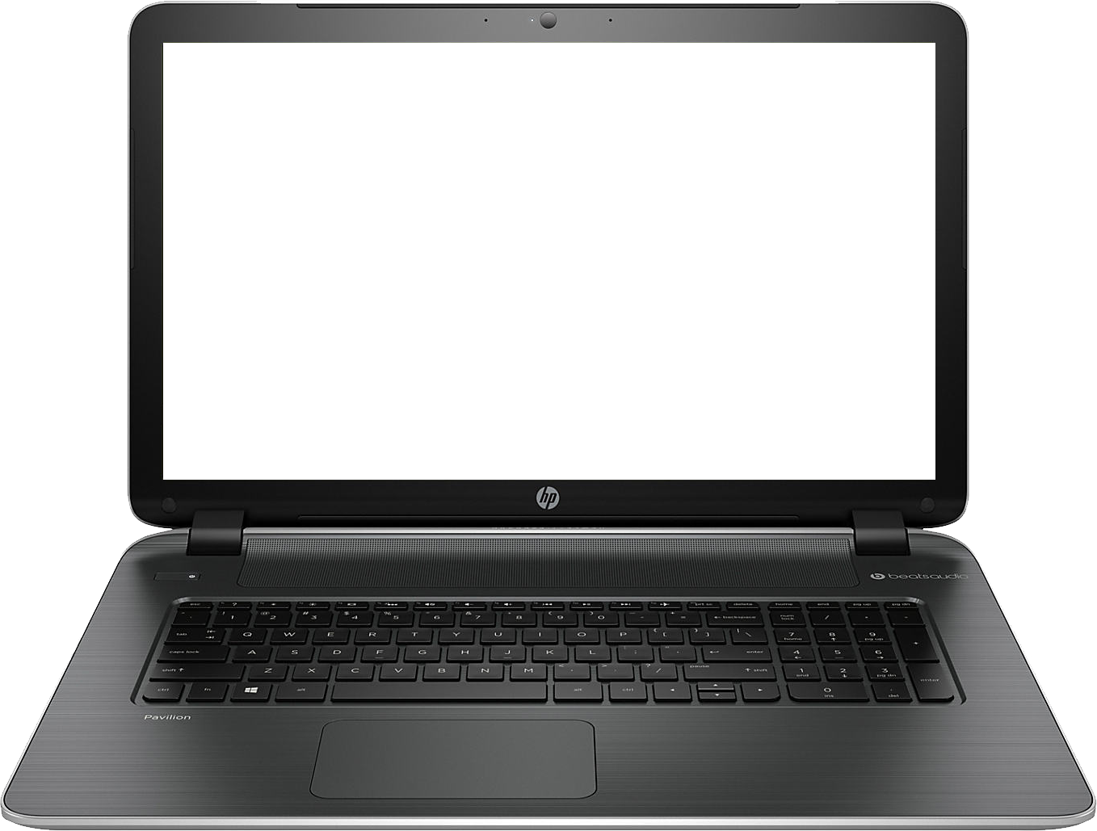
Meanwhile, Client Abstraction
HELLO?!
This Photo by Unknown Author is licensed under CC BY-NC
CLIENT (program) CONNECTS TO MAKE OUTBOUND REQUESTS

Slide 24

Client (program) Needs Return Address
HELLO?!
TO: 192.168.0.1:80
FROM: 192.168.0.2:5280
Usually arbitrary, picked
by operating system
This Photo by Unknown Author is licensed under CC BY-NC
This Photo by Unknown Author is licensed under CC BY-NC
CLIENT (program) CONNECTS TO MAKE OUTBOUND REQUESTS

Slide 25
Incoming Request
I GOT A REQUEST!!!
REQUEST
TO: 192.168.0.1:80
FROM: 192.168.0.2:5280
This Photo by Unknown Author is licensed under CC BY-SA
SERVER RECEIVES REQUEST

Slide 26
Request Response
MY NEW PENPAL!
RESPONSE
TO: 192.168.0.2:5280 FROM: 192.168.0.1:80
This Photo by Unknown Author is licensed under CC BY-SA
SERVER INVERTS TO/FROM FOR RESPONSE

Slide 27
What is a Protocol?
A protocol is the set of rules that govern the interaction of two or more parties
In the context of networking, it defines how two nodes (like client and server) communicate
When a party can communicate
What a party can communicate, including message structure
How a party responds to received communications
Certain outcomes or results are guaranteed when the rules are followed

Slide 28
Overloaded Term
Actually, a protocol often refers to two separate things
FIRST, the rules/specification referred to on the previous slide
SECOND, the computer module that implements the rules

Slide 29
Common Contemporary Protocols
HTTP – HyperText Transfer Protocol
IP – Internet Protocol
SMTP – Simple Mail Transport Protocol

Slide 30
One Protocol is not Enough
There are too many rules for any one protocol to handle
Also, behavior/rules need to change for different hardware/goals
OSI defined a conceptual “stack” of protocols.
Each protocol “layer” can push data down to a lower layer, or pop data up to a higher layer
The protocol on one machine (e.g., client) is a “peer” with the same protocol on the other machine

Slide 31
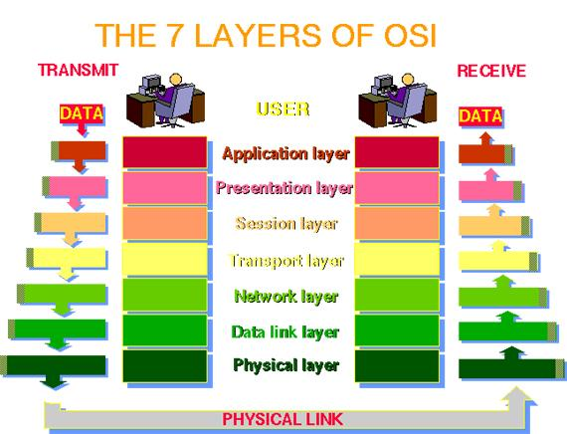

Slide 32
The OSI Model in Practice
Very few systems follow the seven-layer “ideal”
Mostly just care about TCP/IP and the following layers:
Application (Layer 7; example: HTTP)
Transport (Layer 4; TCP)
IP (Layer 3; IP)
Data Link (Layer 2; example: Ethernet or Wifi)
NOTE: It’s common to just refer to a layer by it’s number (e.g., a layer-4 protocol)

Slide 33
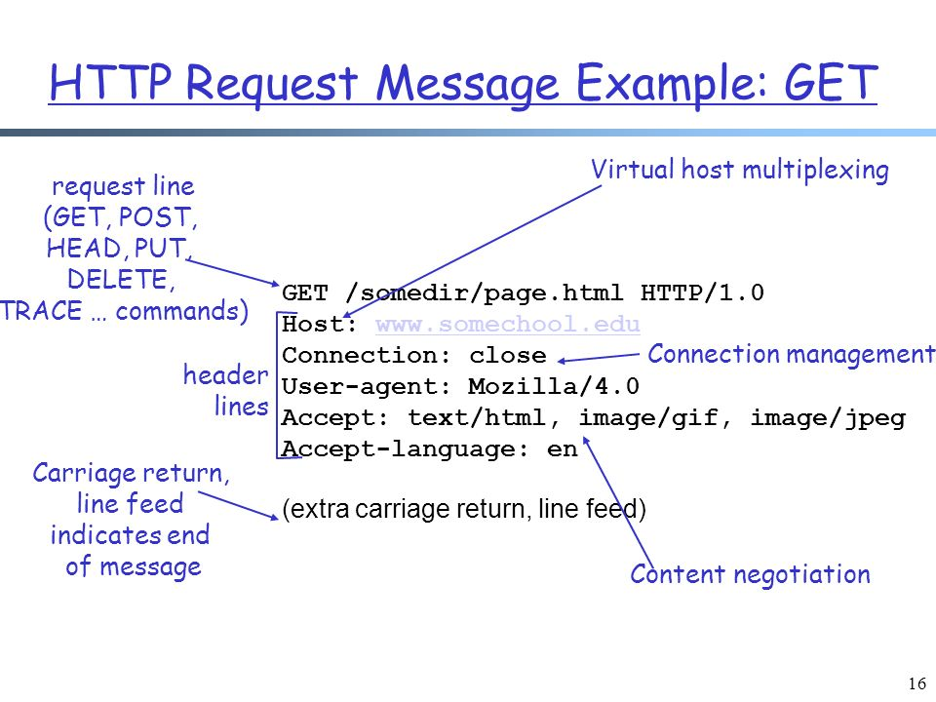
HTTP Request

Slide 34
TCP/IP Send Example
User enters “google.com” into browser
(computer converts “google.com” to an
IP address first).
HTTP is the protocol used for sending/receiving data to/from websites.
TCP deals with making sure the data gets to the right server program correctly
IP is used for getting data over the Internet to the correct machine
MAC is used for communicating on Wifi or Ethernet
HTTP
HTTP Request
TCP
TCP
HTTP Request
IP
IP
TCP
HTTP Request
MAC
MAC
IP
TCP
HTTP Request
Headers. Typically meta data such as “to”, “from”, etc.

Slide 35
TCP/IP Receive Example
Web server program begins gather the requested info. When it has it, it will respond by sending a new message down the stack in the reverse direction
As each layer processes the data, the headers are stripped off. The MAC layer removes the MAC header, the IP layer removes the IP header, etc., before passing the data up. Each layer may or may not need to do some processing based on information in the header.
HTTP Request
HTTP
TCP
HTTP Request
TCP
IP
TCP
HTTP Request
IP
MAC
IP
TCP
HTTP Request
MAC
Conceptually, data arrives at the bottom of the stack
and is processed and then “popped” up to a higher layer

Slide 36
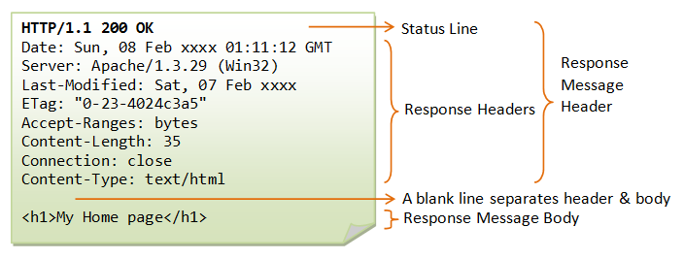
HTTP Response

Slide 37
Wireshark Exercises

